Slide 1
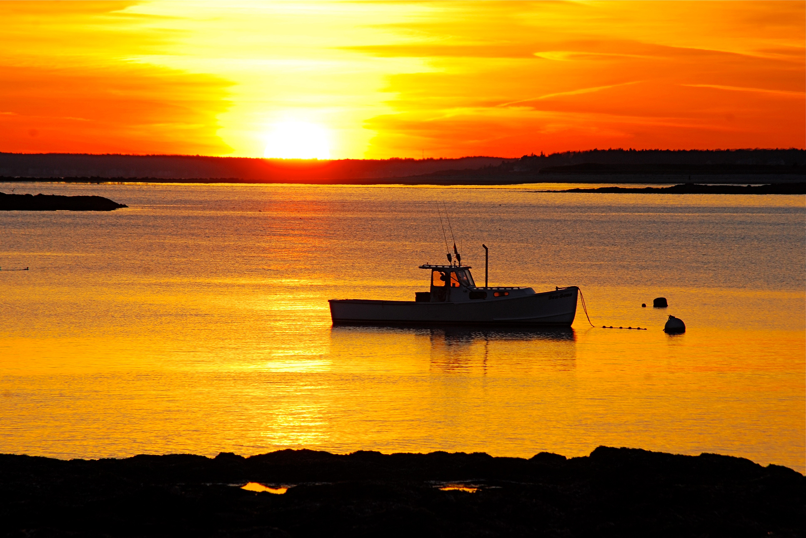
Harbors Committee Report
Town Council Workshop
September 17, 2018

Slide 2
Harbors Committee
Chair James Casey, Citizen Appointment
Stephen Culver, Citizen Appointment
Susan Farady, Citizen Appointment
Caitlin Jordan, Town Councilor
Katherine Ray, Former Town Councilor
Staff Liaison - Stephen Harding, P.E. - Town Engineer
Sebago Technics, Inc.

Slide 3
Staff Contributors
Matthew Sturgis, Town Manager
Debra Lane, Town Clerk
Neil Williams, Police Chief
Ian Anderson, Town Harbormaster
Maureen O’Meara, Town Planner
Wendy Derzawiec, Town Webmaster

Slide 4
Background
Original study – late 1980’s
COASTAL WATERS and HARBOR ORDINANCE
This Ordinance is to establish regulations for marine activities within the harbors, waterways and tidal waters of the Town of Cape Elizabeth, Maine to ensure safety to persons and property, to promote availability and use of a valuable public resource and to create a fair and efficient framework for the administration of that resource. This Ordinance shall be subordinate to existing Federal and State Laws governing the same matters and is not intended to preempt other valid laws.

Slide 5
Harbors Committee Charge 2017
Review the Town’s Coastal Waters and Harbor Ordinance and recommend any changes it deems desirable to the town council.
Meet with state officials to determine options for boat access in the Kettle Cove/Crescent Beach State Park area and develop a long range plan for access.
Update the maps utilized by the harbormaster showing potential locations for moorings.
Inventory public water access.
Assist the comprehensive plan committee with the marine resources section of the comprehensive plan.
Consider such other related matters as the town council may request.

Slide 6
Summary Recommendations
Accept recommended changes to the Town’s Coastal Waters and Harbor Ordinance
(Section 3.0, Page 9).
Resolve Kettle Cove/Crescent Beach area access and circulation issues and implement
other related changes (Section 4.4, Page 15).
Complete the mooring mapping update process, revise the Town website mooring
section to reflect current conditions, and continue to support a professional Harbormaster position (Section 5.0, Page 17).
Maintain and improve upon places of public water access (Section 6.0, Page 19).
Maintain a working waterfront by providing a balance between commercial and
recreational uses (Section 8.0, Page 32).
Take actions to mitigate adverse sea level rise consequences. (Section 9.0, Page 34).
Conduct a comprehensive review of the Town’s marine resources and its management
on a time frame not to exceed a 10-year duration. (Section 10.0, Page 36).

Slide 7
Resident Survey
Survey goal – to gain current understanding and insights into how residents use and attitudes toward the Cape shoreline and waterways.
Total respondents - 497

Slide 8
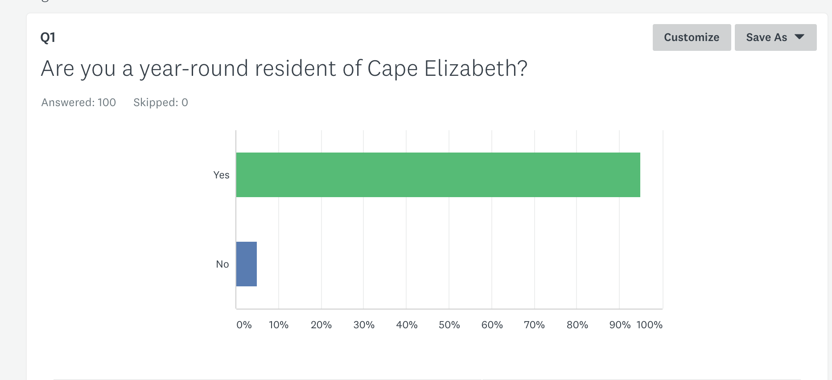
Virtually all respondent were year-round Cape residents.

Slide 9
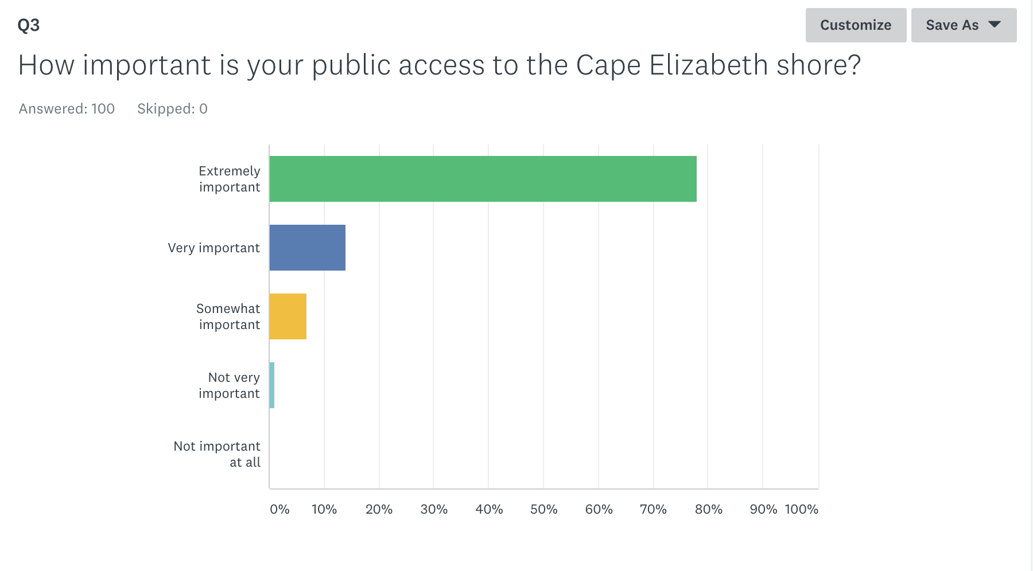
Public access is “Extremely/Very Important” to 92% of respondents
Reason we live/moved here
- Residents are very protective of the access they have now

Slide 10
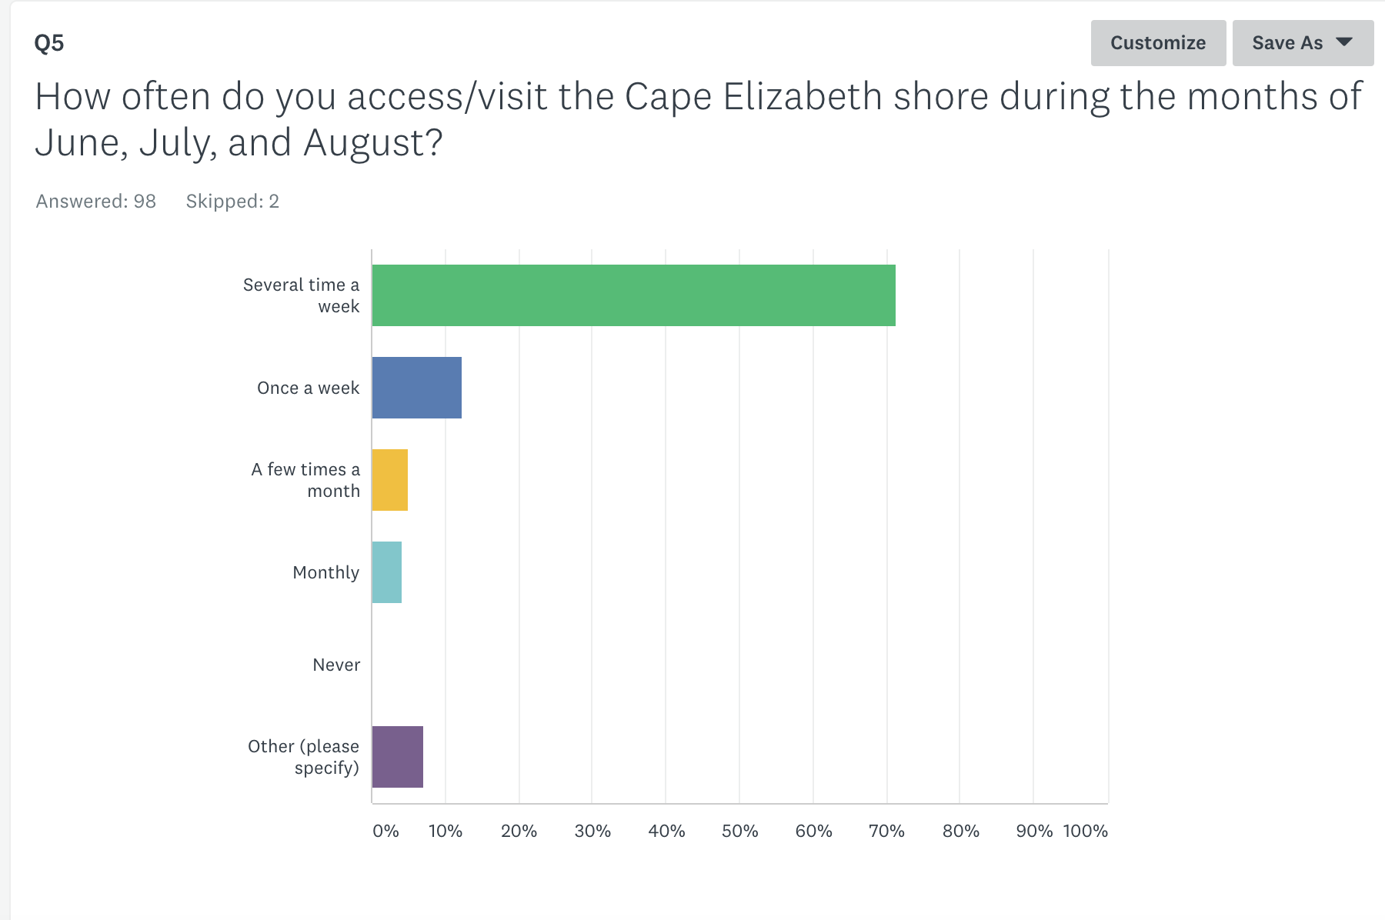

Slide 11
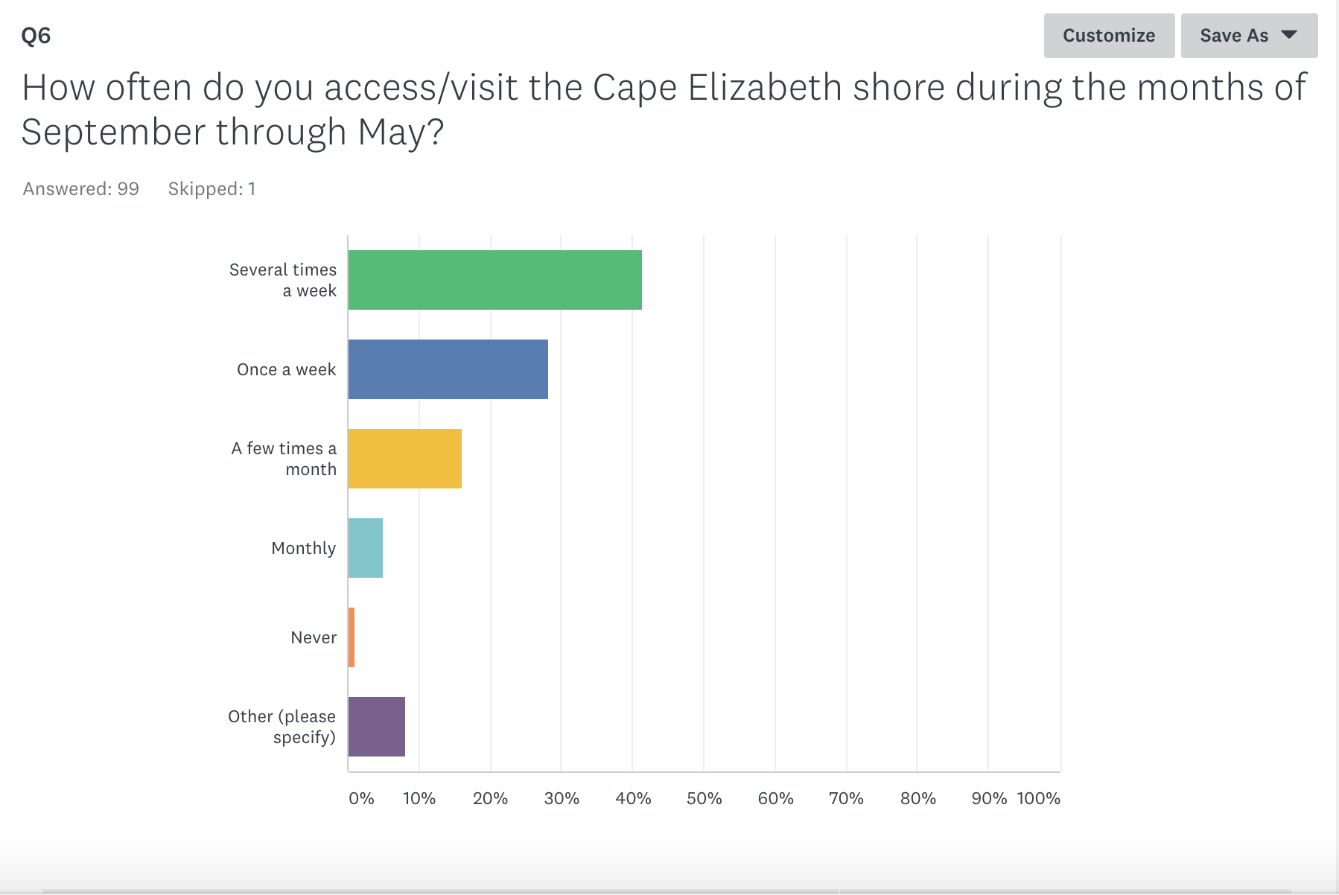
Shoreline visitation year round.

Slide 12
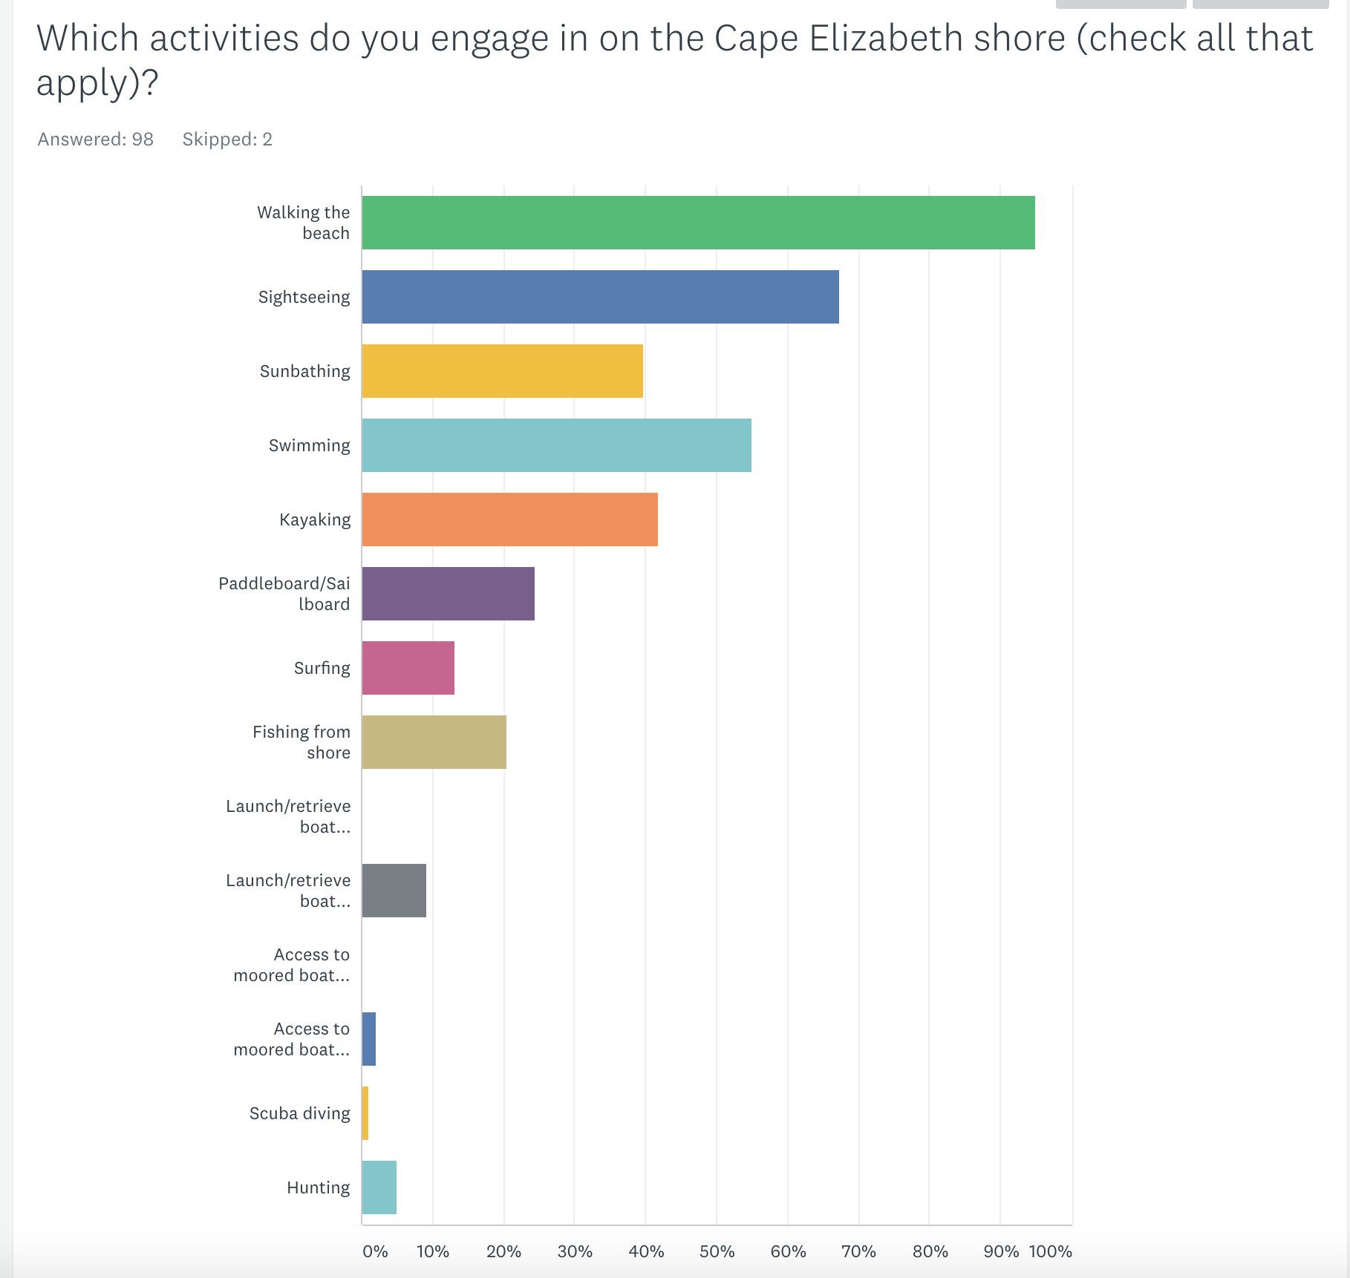
Residents engage in the range of shoreline activities – swimming, boating, walking, fishing, etc.

Slide 13
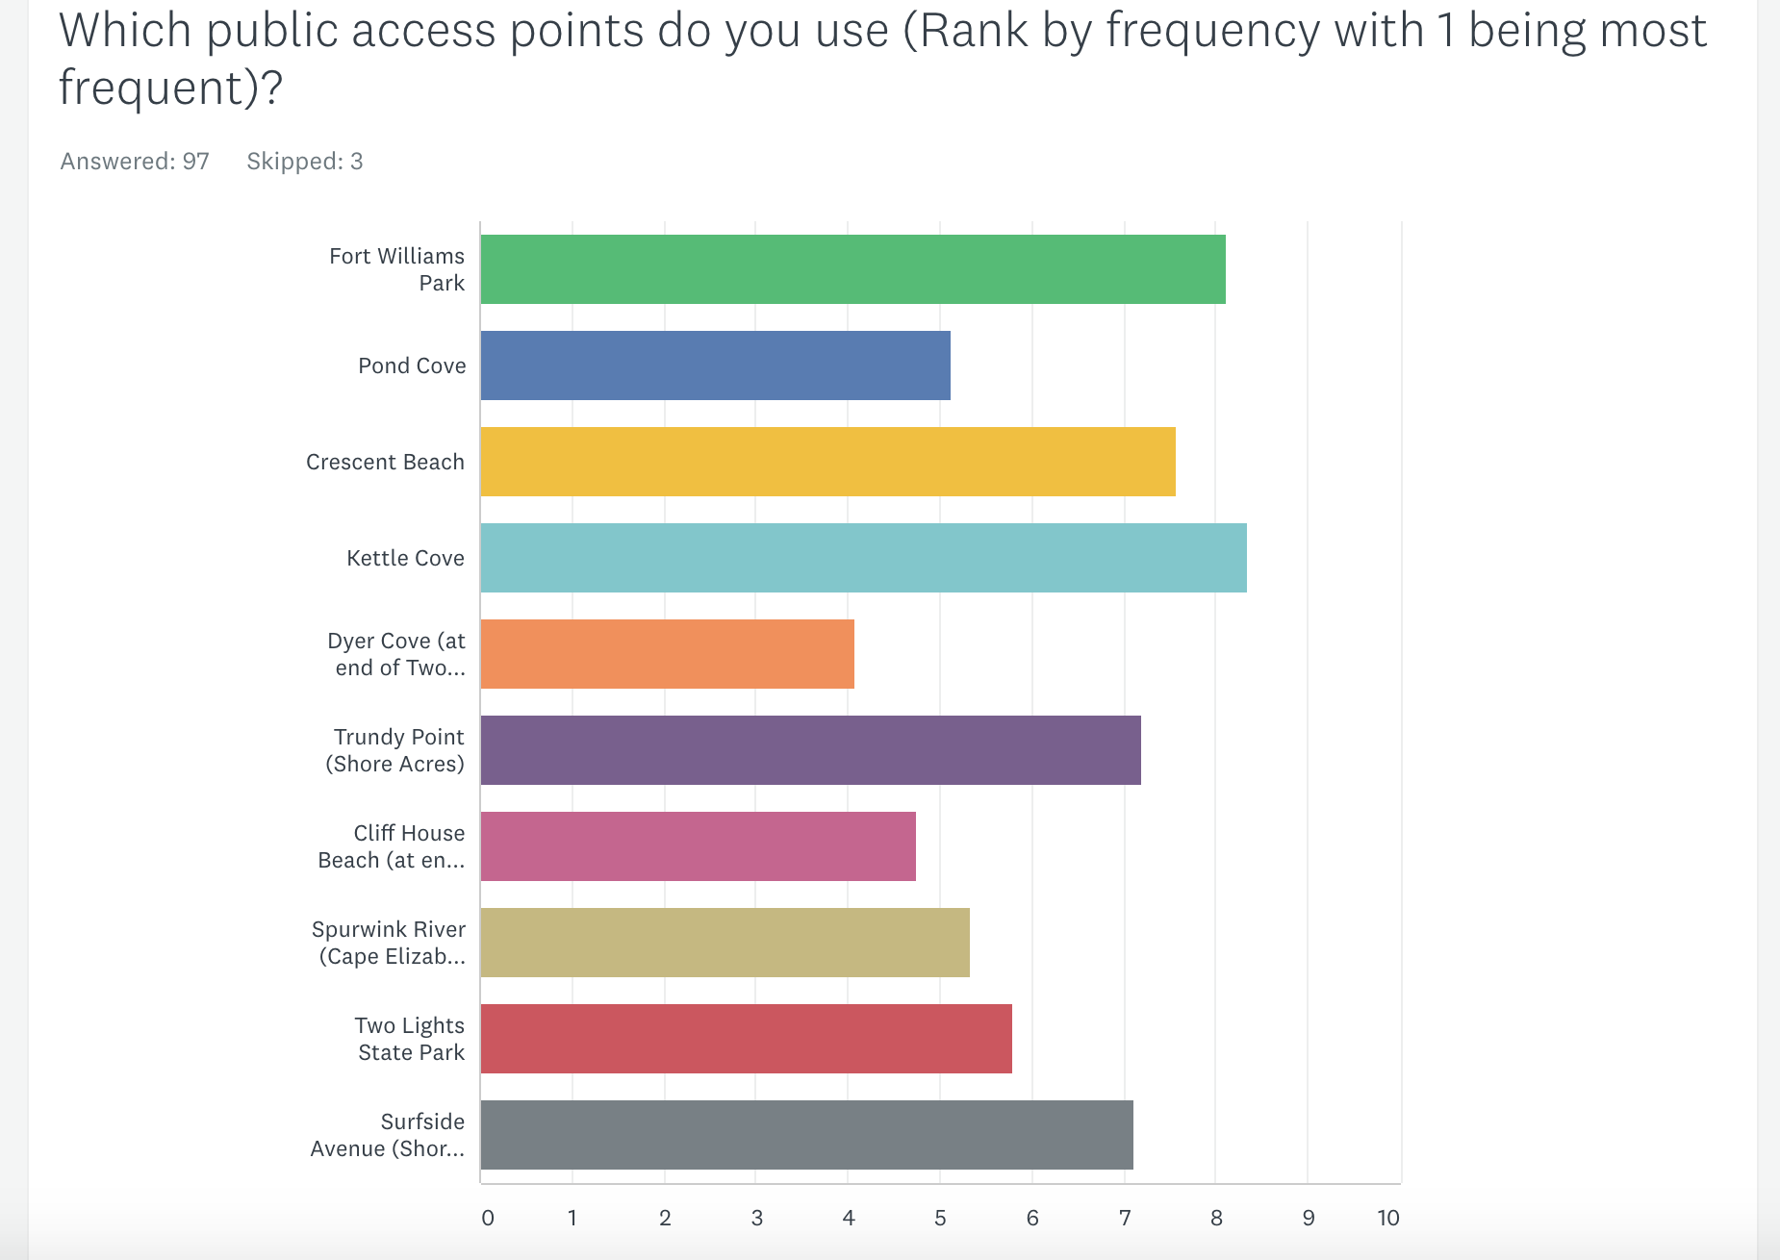
Top 3 access points: Fort Williams, Kettle Cove and Crescent Beach.

Slide 14
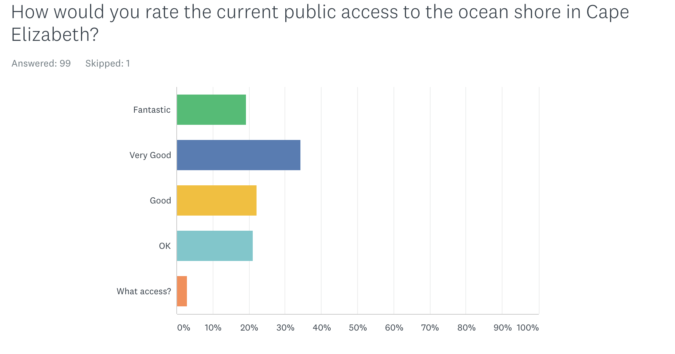
Over half of respondents were satisfied with current public access.

Slide 15
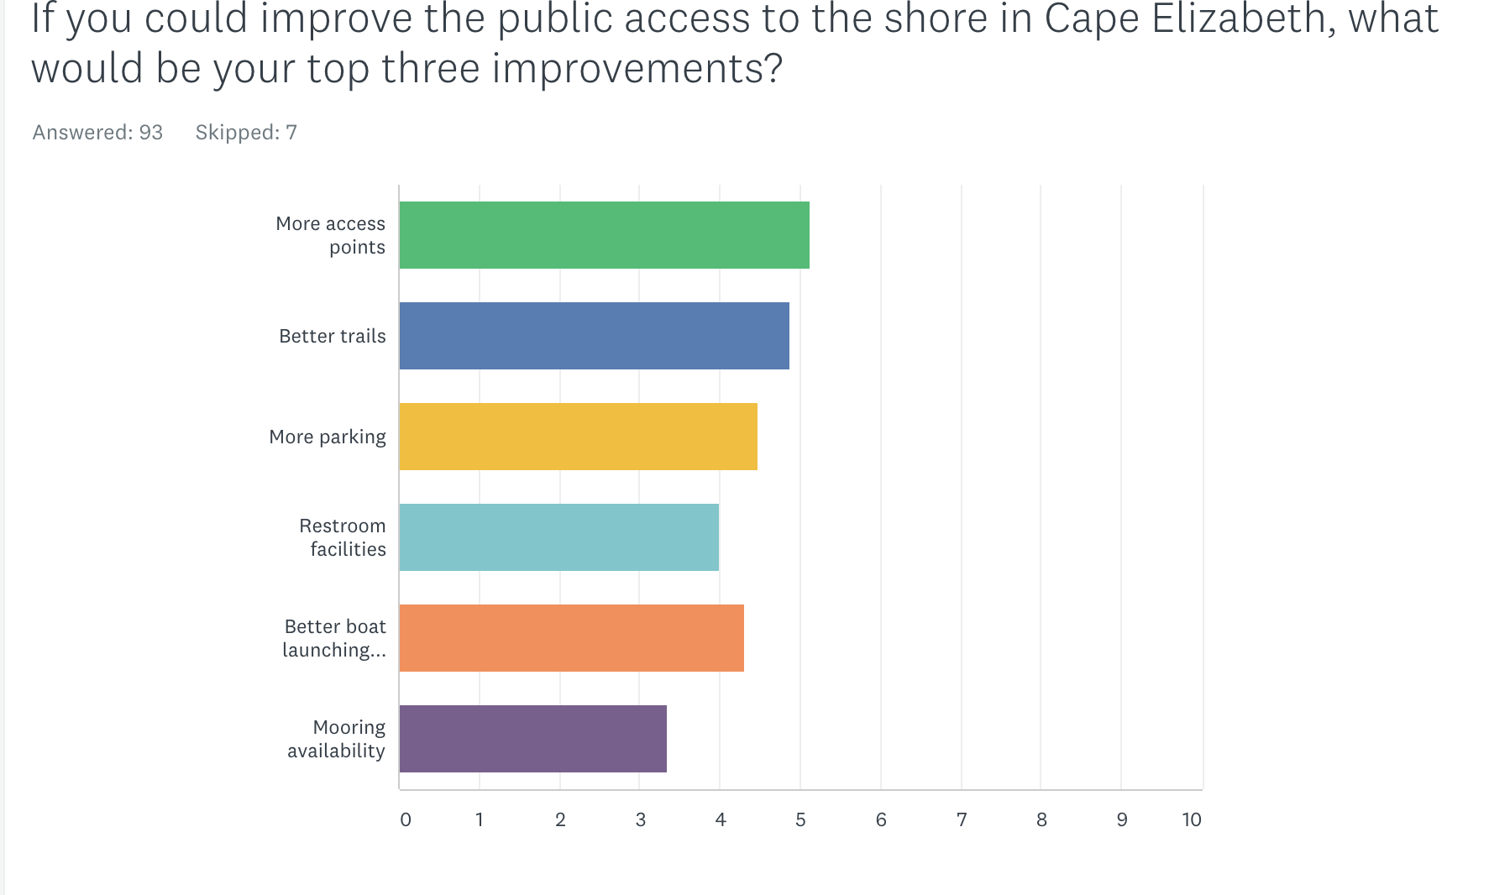
Asked how residents would improve public access point the top 3 suggestions: More access points, Better trails and More parking.

Slide 16
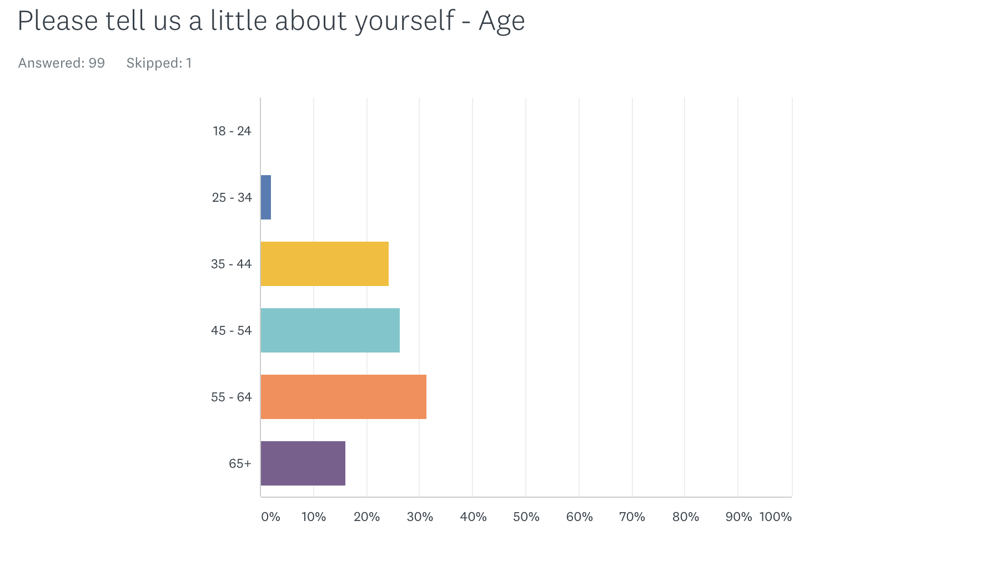
Roughly half of respondents were over 55; and half under 55.

Slide 17
Committee Charges
Review the Town’s Coastal Waters and Harbor Ordinance and recommend any changes it deems desirable to the Town Council.
Meet with state officials to determine options for boat access in the Kettle Cove/Crescent Beach State Park area and develop a long-range plan for access.
Update the maps utilized by the Harbormaster showing potential locations for moorings.
Inventory public water access.
Assist the Comprehensive Plan Committee with the marine resources section of the Comprehensive Plan.
Consider such other related matters as the Town Council may request.

Slide 18
Coastal Waters and Harbor Ordinance Review Charge
Change “black can buoy ‘C-1’” to “can buoy ‘C-1’” as
the buoy has been painted green
Add a definition for “Houseboat”
Add a definition for “Outhaul”
Eliminate the word “extreme” in the phrase “extreme
emergency”
5. Add provisions and requirements associated with
houseboats to regulate their use in the community
6. Add limits to the size of vessels covered by the outhaul
provisions and requirements associated with an outhaul

Slide 19
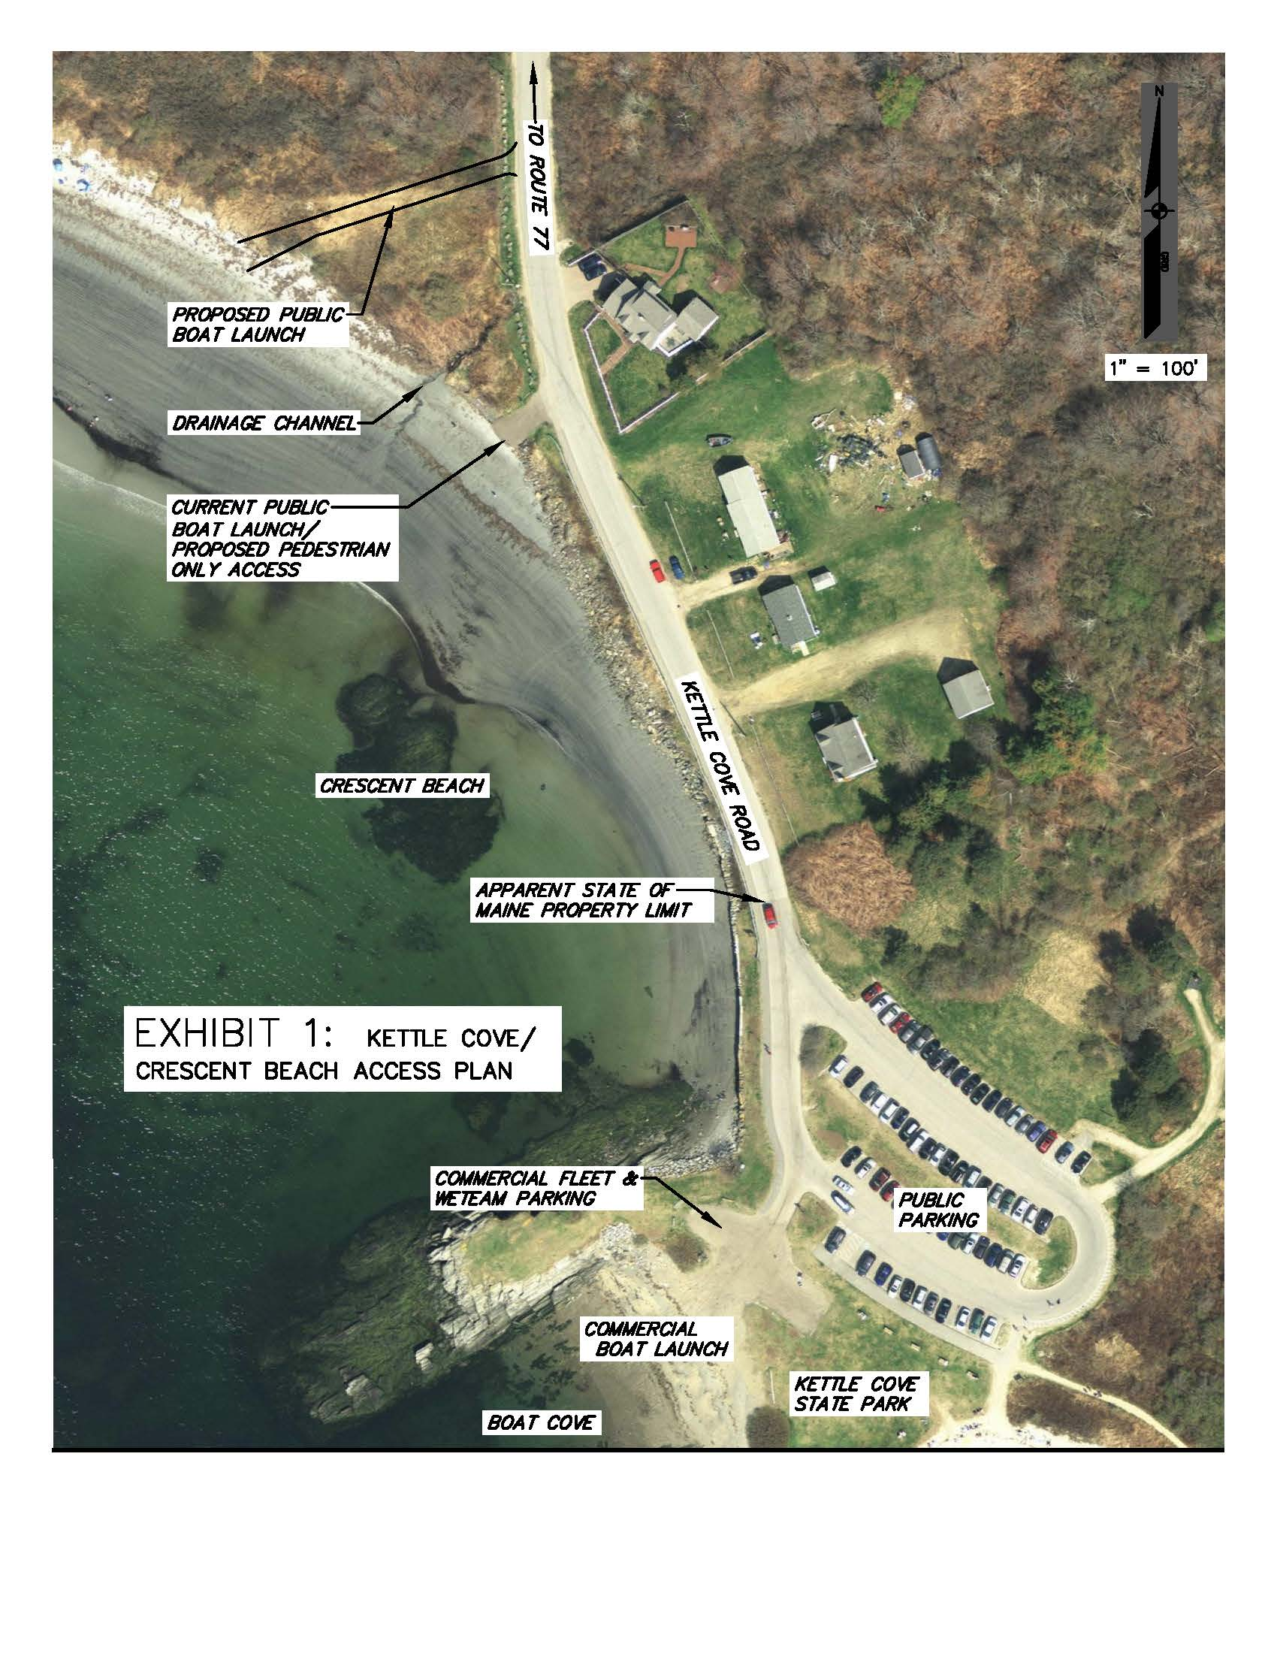

Slide 20
Kettle Cove/Crescent Beach State Park Area Assessment Charge
The Current Situation:
Limited Commercial Beach Launch Area
WETeam’s only suitable launch site in Cape Elizabeth
Challenging Public Access
The State of Maine Perspective:
Prioritize Crescent Beach for parking for public use
Preservation of the human experience as well as to promote the obligation to protect wildlife and their natural habitat from human intervention
Supports the Town in changes to the area – no funds available
Potential Solutions:
Relocation of the existing Town public beach access to a historical boat launching area
Utilize the existing boat launch as a pedestrian-only access point
Clearly separate uses and proper signage stipulating these uses
Obtain a recorded easement for the continued and unabated rights of the commercial fleet and WETeam to utilize the Boat Cove launch area.

Slide 21
Kettle Cove/Crescent Beach Recommendations
Enter into an agreement with the State stipulating each parties’ understandings and responsibilities associated with the relocation of the public vehicle beach access to the historical boat launch.
Secure an easement from the State of Maine that would allow the Town to construct and maintain the improvements and then operate the new public vehicle beach access site.
Investigate and seek grant opportunities.
Design, permit, construct, maintain, and operate the new public vehicle beach access area while repurposing the existing beach access area to provide safe pedestrian-only access to Crescent Beach.
Secure an easement for the uninterrupted use of Boat Cove for use by the Town’s commercial fishermen and WETeam.
Support the collaborative activities of the Town’s Police Department in providing enforcement and support to the State of Maine.
Encourage the State of Maine to share and promote their management goals, continue to build upon the ongoing cooperative discussion with State of Maine representatives, and clearly document any future collaborative interactions and agreements in writing.

Slide 22
Moorings Mapping Update Charge
Town conducts the administrative duties of the Harbormaster position through its staff within the Police Department and provides a Harbormaster presence on the water by sharing its Harbormaster with the adjacent Town of Scarborough
Complete the mooring mapping update in 2018 and utilize that information to address any discrepancies in the Police Department’s official mooring record
Update information on the Town website’s mooring pages so that the information is current & users of this information can be assured of its reliability

Slide 23
Public Water Access Inventory Charge
Federal Properties - Dyer Cove (10-acres)
State of Maine Properties - Two Lights State Park (42-acres), Kettle Cove State Park (67-acres) & Crescent Beach State Park (212-acres)
Cape Elizabeth Land Trust Properties - Trundy Point (2-acres) & Pond Cove from Shore Road (1.25-acres)
Town of Cape Elizabeth Properties - Fort Williams Park (96-acres), Cliff House Beach (0.25 acres), Spurwink River Marsh (150-acres) & Surfside Avenue (Rights to 2,000 linear feet)
Public Survey - Demonstrated that the coastline of Cape Elizabeth is a valued treasure in the community and that its protection/improvement are very much supported
Cape Elizabeth Shoreline - Contains High Value Plant and Animal Habitat particularly in the the southwesterly area of Town that are protected from development impact with the Town’s stringent wetland and coastal zoning

Slide 24
Comprehensive Plan - Marine Resources
Section Charge
Met with Town Planner Maureen O’Meara to gain insight and direction
Prepared 15-page Marine Resources Section to the Comprehensive Plan
Met with the Comprehensive Plan Committee in a workshop setting to review the Marine Resources Section and share findings from the Harbor Committee Report

Slide 25
Other Related Matters
Cape Elizabeth Sea Level Rising Vulnerability Assessment
Executive Summary from June 2015 “Cape Elizabeth Sea Level Rising Vulnerability Assessment” report as prepared by the Portland Council of Governments.
Evaluate risk to PWD’s wastewater pumping station on Spurwink Ave
Raise Sawyer Road and minor span
Raise Shore Road and improve culvert
Raise Spurwink Avenue and improve culvert
Review capacity and design of culverts Town-wide
Coordinate with the Portland Water District and South Portland to evaluate risk to underground utilities
Improve accuracy of GIS layer for “Normal High Water Line” (HAST+3ft).
Include sea level rise language in next comprehensive plan update
Revise septic ordinance to consider impacts of sea level rise
Incorporate Low Impact Development (LID) techniques in land use ordinances

Slide 26
Harbors Committee Recommendations:
Accept recommended changes to the Town’s Coastal Waters and Harbor Ordinance
Resolve Kettle Cove/Crescent Beach area access and circulation issues and implement other related changes
Complete the mooring mapping update process, revise the Town’s website mooring section to be reflect current conditions, and continue to support a professional Harbormaster position
Maintain and improve upon places of public water access
Maintain a working waterfront by providing a balance between commercial and recreational uses
Take actions to mitigate adverse sea level rise consequences
Conduct a comprehensive review of the Town’s marine resources and its management on a time frame not to exceed a 10-year duration.

